Slide 1
NEPHRITIS RISK SCORE MODEL USING NHANES DATABASE
JUNE 15, 2020
MENGHONG HAN & JEMMA RONG

Slide 2
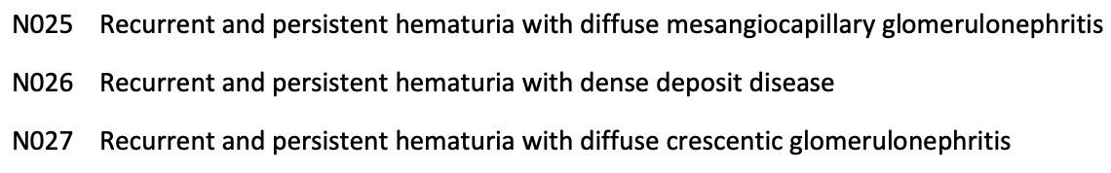

Introduction
Definition of Nephritis:
Nephritis is a condition in which the nephrons, the functional units of the kidneys, become inflamed. This inflammation, which is also known as glomerulonephritis, can adversely affect kidney function.
ICD10 Code for Chronic Nephritis: (Target Variable in the model)

Slide 3
Chronic Glomerulonephritis
Symptoms:
Blood or protein in the urine
High blood pressure
Swelling of your ankles or face (edema)
Frequent nighttime urination Kidney Conditions
Very bubbly or foamy urine
Causes:
Family history
Young men who have hearing loss and vision loss (early signs)
Changes in the immune system
One acute attack of glomerulonephritis

Slide 4
Chronic Glomerulonephritis (cont.)
Diagnosis:
Blood tests: Serum Creatinine/ Glomerular Filtration Rate(GFR)/ Blood Urea Nitrogen (BUN)
Imaging Tests: Ultrasound/ CT Scan
Urine Tests: Urinalysis/ Urine Protein/ Microalbuminuria/ Creatinine Clearance
Kidney Biopsy

Slide 5
Chronic Kidney Disease (CKD)
The five stages of CKD are:
Stage 1: Kidney damage with normal kidney function (estimated GFR ≥90 mL/min per 1.73 m2) and persistent (≥3 months) proteinuria.
Stage 2: Kidney damage with mild loss of kidney function (estimated GFR 60-89 mL/min per 1.73 m2) and persistent (≥3 months) proteinuria.
Stage 3: Mild-to-severe loss of kidney function (estimated GFR 30-59 mL/min per 1.73 m2).
Stage 4: Severe loss of kidney function (estimated GFR 15-29 mL/min per 1.73 m2).
Stage 5: Kidney failure requiring dialysis or transplant for survival. Also known as ESRD (estimated GFR <15 mL/min per 1.73 m2).
Thoughts:
Maybe we could try to classify CKDs in different stages and give different risk scores respectively.

Slide 6
Chronic Kidney Disease (CKD) (cont.)
Causes:
High blood pressure
Diabetes
Cardiovascular disease
Symptoms:
Chest pain/ Dry skin/ Itching or numbness/ Feeling tired/ Headaches/ increased or decreased urination/ loss of appetite/ muscle cramps/ nausea/ shortness of breath/ sleep problems/ trouble concentrating/ vomiting/ weight loss

Slide 7
Variables in the NHANES Database
Number | Function | Variable Name | Column name | Type | Source | Description
1 | Target | Albumin creatinine ratio | abnormal | Category | ALB_CR_I | Whether Albumin creatinine ratio (mg/g) is higher than 30?
1 | Predictor | High blood pressure | BPQ020 | Category | BPQ_I | Ever told you had high blood pressure
2 | Predictor | Frequent high blood pressure | BPQ030 | Category | BPQ_I | Told had high blood pressure - 2+ times
3 | Predictor | Albumin | URDUMALC | Continuous | ALB_CR_I | Albumin, urine (mg/L)
4 | Predictor | Creatinine | URDUCRLC | Continuous | ALB_CR_I | Creatinine, urine (mg/dL)
5 | Predictor | Diabetes | DIQ010 | Category | DIQ_I | Doctor told you have diabetes
6 | Predictor | Nighttime Urinate | KIQ480 | Continuous | KIQ_U_I | How many times urinate in night?
7 | Predictor | Coronary heart disease | MCQ160C | Category | MCQ_I | Ever told you had coronary heart disease
8 | Predictor | Congestive heart failure | MCQ160B | Continuous | MCQ_I | Ever told had congestive heart failure
9 | Predictor | Heart attack | MCQ160E | Category | MCQ_I | Ever told you had heart attack
10 | Predictor | Gender | RIAGENDR | Category | DEMO_I | Gender
11 | Predictor | Race | RIDRETH3 | Category | DEMO_I | Race/Hispanic origin w/ NH Asian
12 | Predictor | Age | RIDAGEYR | Continuous | DEMO_I | Age in years at screening

Slide 8
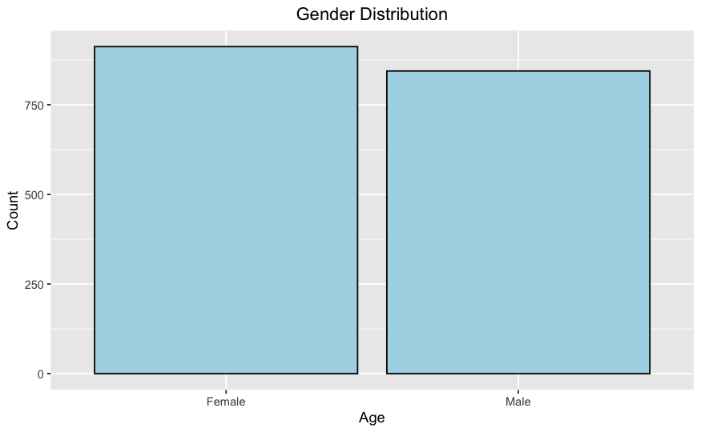
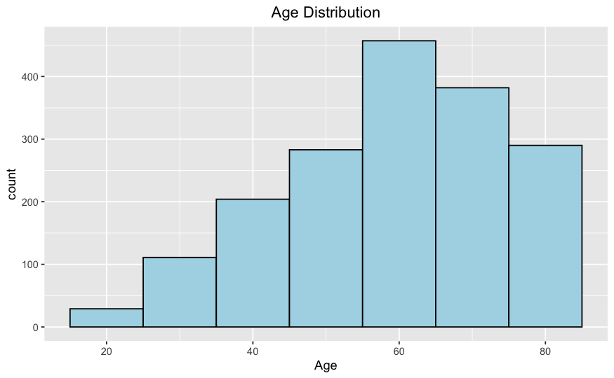
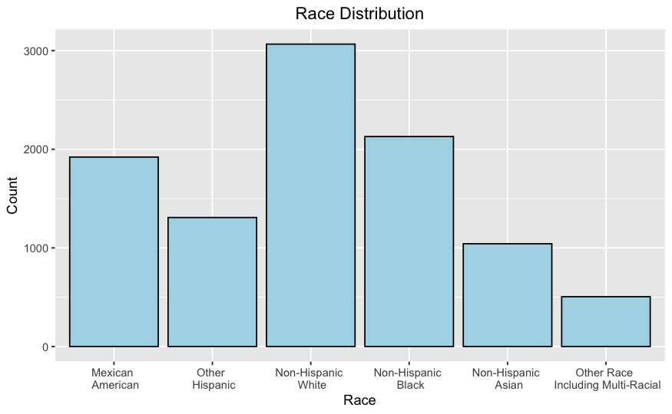
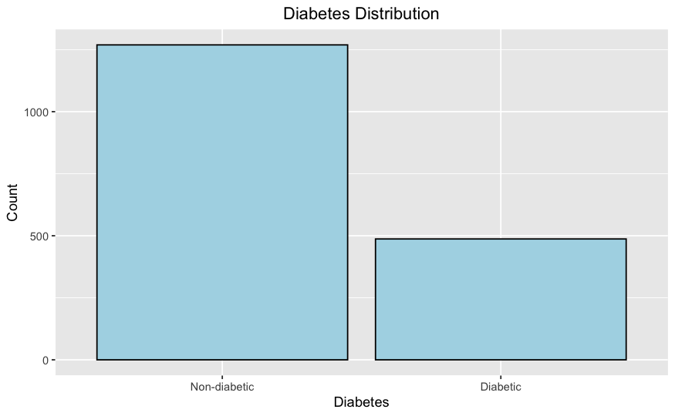
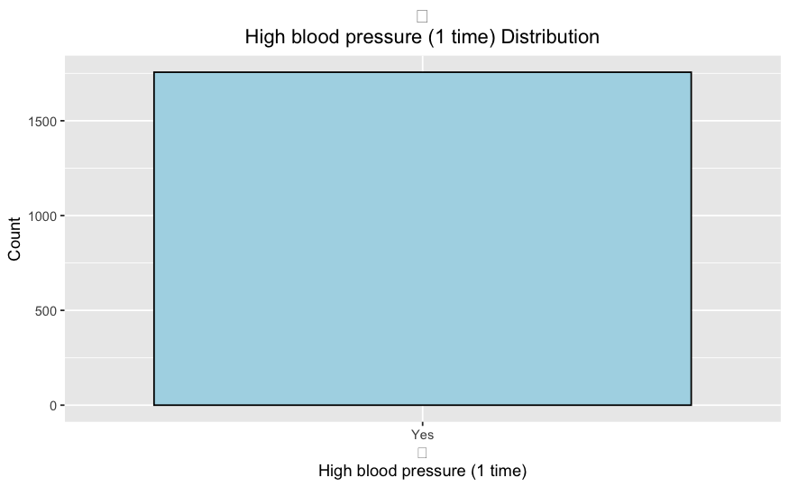
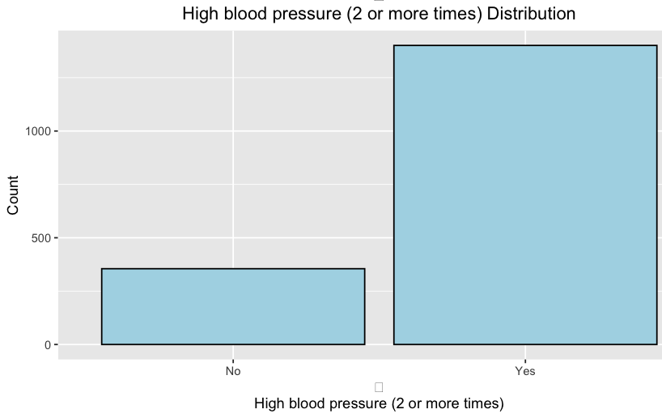
Predictors Description

Slide 9
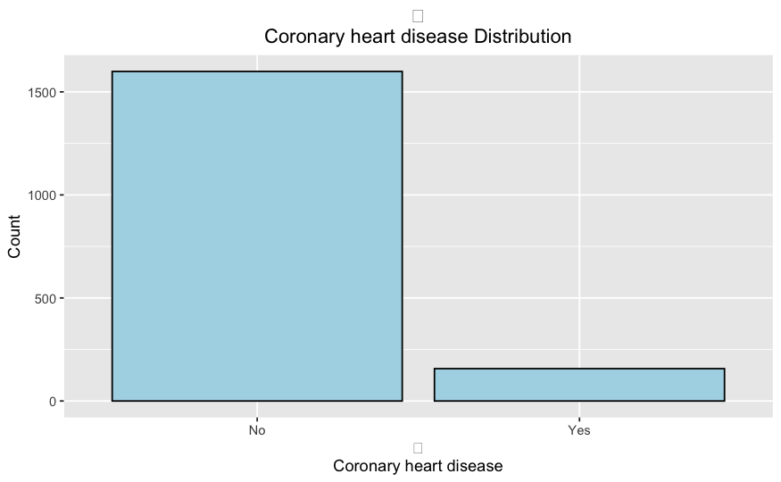
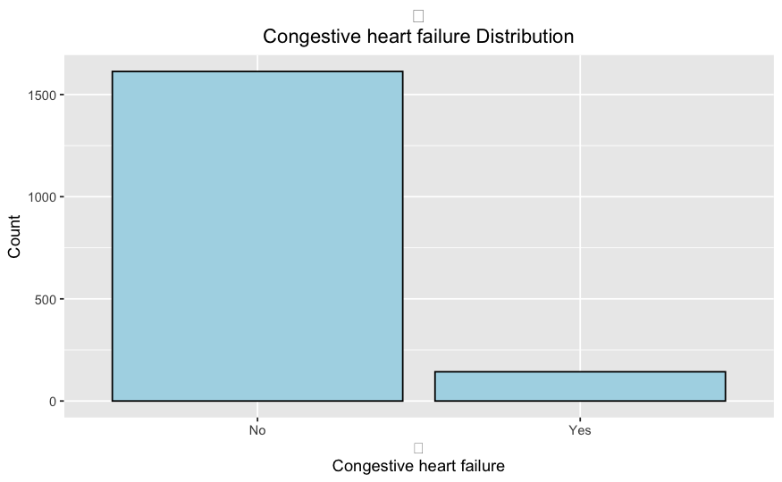
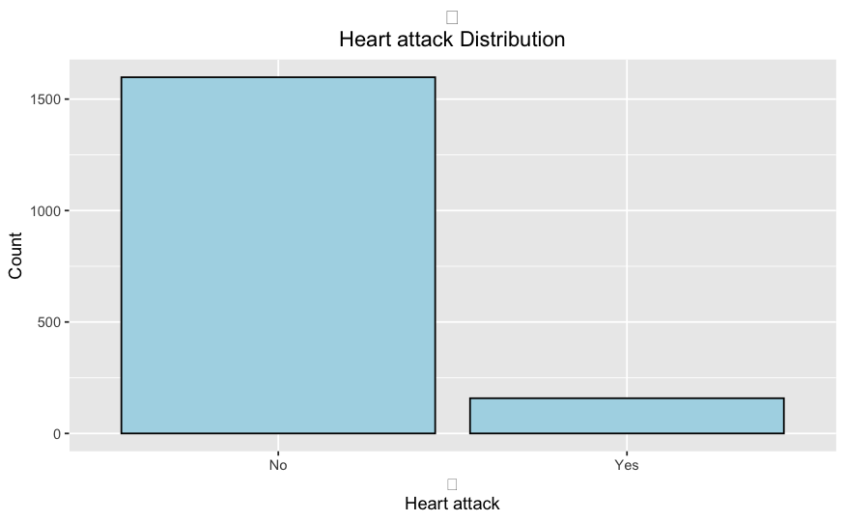
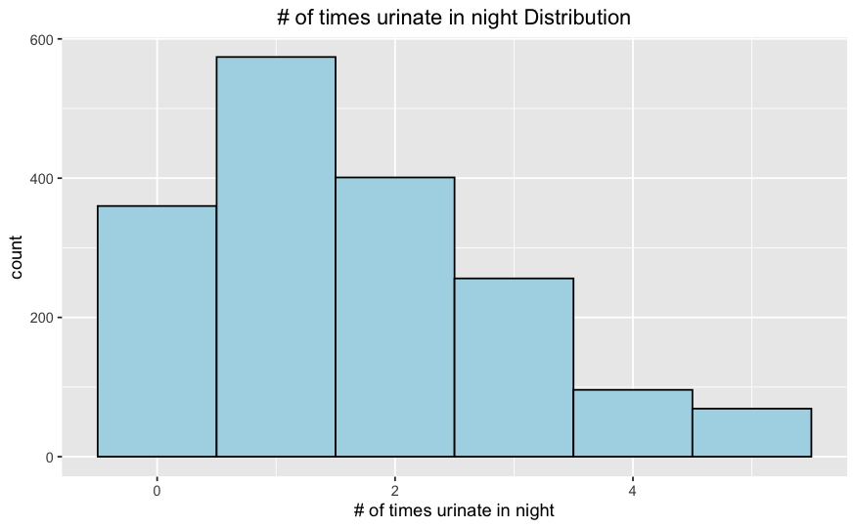
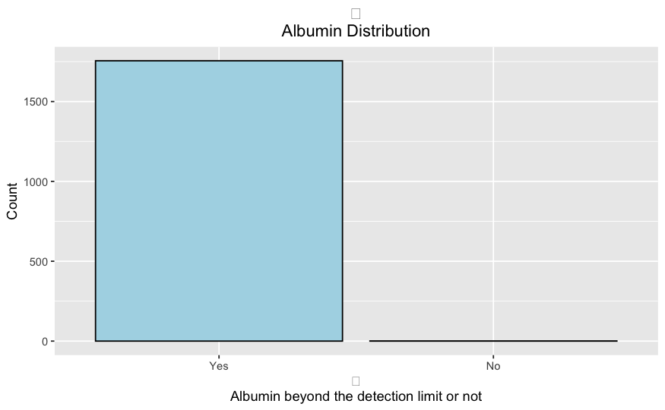
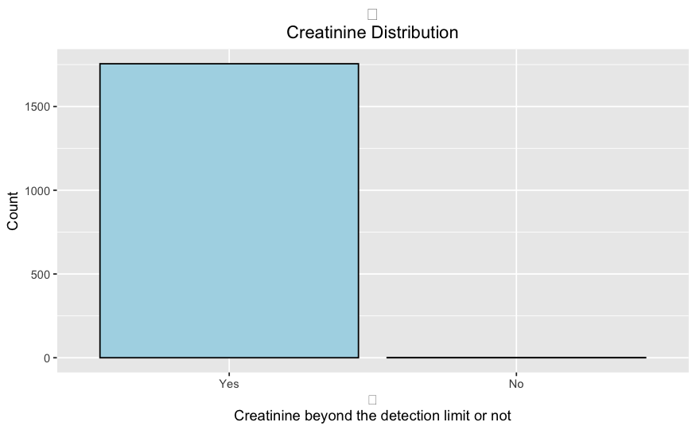
Predictors Description (cont.)

Slide 10
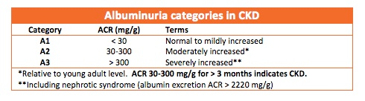
Risk Score Modeling Process
Basic Model:
Logistic Regression (final output: the probability of answering “Yes” regarding “Whether Albumin creatinine ratio (mg/g) is higher than 30?”)
Note: For patients whose Albumin creatinine ratio > 30, they have the abnormal ACR.
Modeling Process flow:
Input data (predictors & target) 🡺 Split data (75% training & 25% testing) 🡺 Use training data to get the predictive model 🡺 Use testing data to get the risk scores
Model Prediction Accuracy:
70% (the probability of right prediction)

Slide 11
Risk Score Table (sample)
 | Gender | Age | Race: Non-Hispanic White | Race: Non-Hispanic Black | Race: Mexican American | Race: Other Hispanic | Race: Non-Hispanic Asian | Diabetes | High blood pressure (1 time) | High blood pressure (2 or more times) | Coronary heart disease | Congestive heart failure | Heart attack | # of times urinate in night | Albumin | Creatinine | Risk Score
1 | 0 | 80 | 0 | 1 | 0 | 0 | 0 | 0 | 1 | 1 | 0 | 0 | 0 | 2 | 0 | 0 | 51.39
2 | 0 | 69 | 0 | 0 | 1 | 0 | 0 | 0 | 1 | 1 | 0 | 0 | 0 | 1 | 0 | 0 | 46.70
3 | 0 | 54 | 0 | 1 | 0 | 0 | 0 | 0 | 1 | 1 | 0 | 0 | 0 | 1 | 0 | 0 | 34.75
4 | 1 | 80 | 0 | 1 | 0 | 0 | 0 | 0 | 1 | 1 | 0 | 1 | 0 | 2 | 0 | 0 | 67.32
5 | 0 | 45 | 0 | 1 | 0 | 0 | 0 | 0 | 1 | 1 | 0 | 0 | 0 | 3 | 0 | 0 | 38.74
6 | 0 | 53 | 1 | 0 | 0 | 0 | 0 | 0 | 1 | 1 | 0 | 0 | 0 | 1 | 0 | 0 | 31.87
7 | 1 | 62 | 0 | 1 | 0 | 0 | 0 | 0 | 1 | 1 | 0 | 0 | 0 | 2 | 0 | 0 | 44.75
8 | 1 | 44 | 1 | 0 | 0 | 0 | 0 | 1 | 1 | 1 | 0 | 0 | 0 | 0 | 0 | 0 | 42.68
9 | 1 | 70 | 1 | 0 | 0 | 0 | 0 | 1 | 1 | 1 | 0 | 0 | 0 | 2 | 0 | 0 | 63.70
Range of risk score: 0-100
A higher risk score, a higher risk of contracting Nephritis given current physical condition.

Slide 12
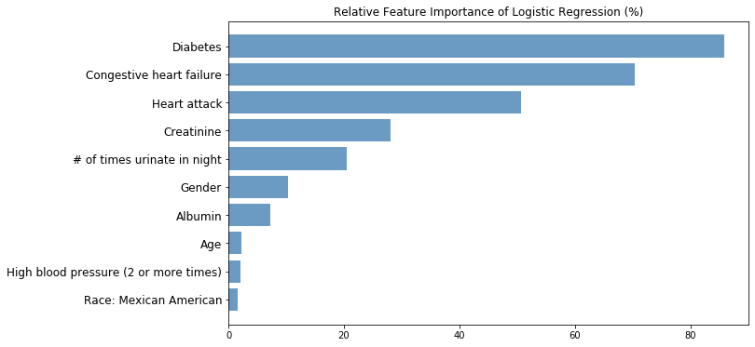
Feature Importance
Rank by the weights of predicting target variable

Slide 13
Result Interpretation (cont.)
Diabetes:
According to National Institute of Diabetes and Digestive and Kidney Diseases, Diabetes is the leading cause of kidney disease. About 1 out of 4 adults with diabetes has kidney disease.
High blood glucose, also called blood sugar, can damage the blood vessels in your kidneys. When the blood vessels are damaged, they don’t work as well.
Congestive Heart Failure:
Relatively recent research has shown that heart failure is a significant risk factor for kidney disease. When the heart is no longer pumping efficiently it becomes congested with blood, causing pressure to build up in the main vein connected to the kidneys and leading to congestion of blood in the kidneys, too.

Slide 14
Result Interpretation (cont.)
Gender:
Gender is an important factor considering predicting Nephritis. According to Medscape, there is a male predominance in the occurrence of nephrotic syndrome, as for chronic kidney disease in general. This male overrepresentation is also seen in paraneoplastic membranous nephropathy. But lupus nephritis affects mostly women.
However, according to Fisher‘s exact test result, there is no significant difference between male and female in contracting Nephritis in this dataset. Main Reason: imbalanced & small dataset size
High blood pressure:
Damaged kidneys may release too much of an enzyme called renin, which helps to control blood pressure. This increases your risk for heart attack, congestive heart failure and stroke.

Slide 15
Result Interpretation (cont.)
Race:
A growing number of Hispanics are diagnosed with kidney disease each year. Since 2000, the number of Hispanics with kidney failure has increased by more than 70 percent.
Compared to non-Hispanics, Hispanics are almost 1.3 times more likely to be diagnosed with kidney failure.

Slide 16
Things need to be further explored…
How does the model perform when applied to different datasets ( such as EHR data)
How to combine feature importance with risk score? For example, for a patient, he gets the risk score of Nephritis about 70. we can tell him the important factors in our models are diabetes etc. Then, how do we know whether this patient perform good or bad in each specific factor?
Albumin creatinine ratio, which is our target variable here, needs long-term supervision. ACR is larger than 30 for 30 days is considered CKD. However, we just used one-time data. How to fix this problem and deliver more accurate result?
Model optimization. We need to keep playing with different predictive models to see which one performs the best.

Slide 17
Possible Solution for Problem 2
Problem 2 Statement:
We can only get feature importance for the whole model, while each factor may have different impact on different individuals, we cannot see the performance of individuals in each specific factor.
Feature importance could vary from models, it could even be different within a model with different calculation options. We need to find a measure can are both consistent and accurate.
Solution:
Use “SHAP value” and show the visualization feature importance for each individual after showing the risk score.

Slide 18
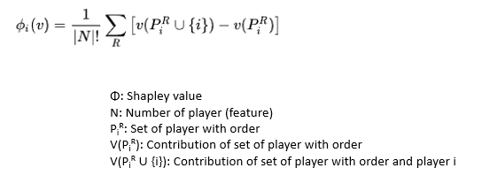
SHAP: SHapley Additive exPlanation
SHAP (SHapley Additive exPlanation) is a game theoretic approach to explain the output of any machine learning model. The goal of SHAP is to explain the prediction for any instance xᵢ as a sum of contributions from it’s individual feature values. Individual feature values are assumed to be in a cooperative game whose payout is the prediction. In this setting, Shapley values provides a measure to fairly distribute the payout among the feature values.

Slide 19
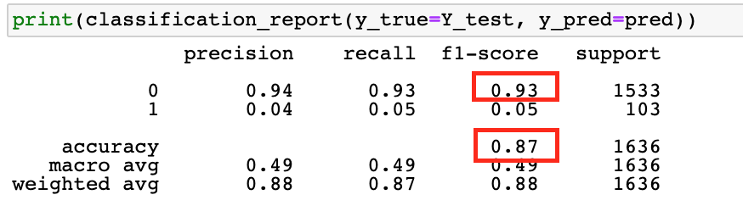
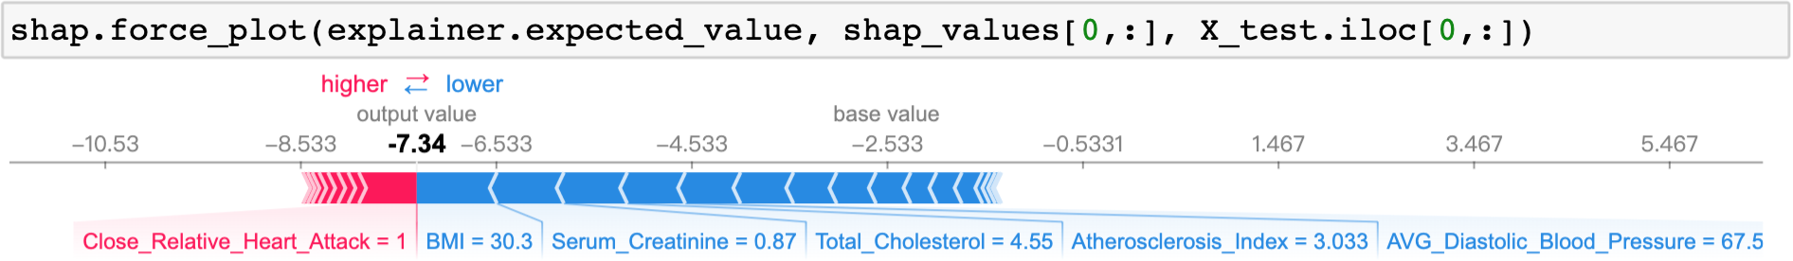
Visualization with heart disease dataset
Model: XGBtree: eXtreme Gradient Boosting Tree
Risk Score: 99.935020

Slide 20
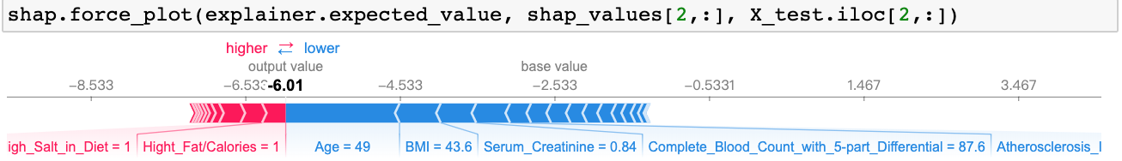
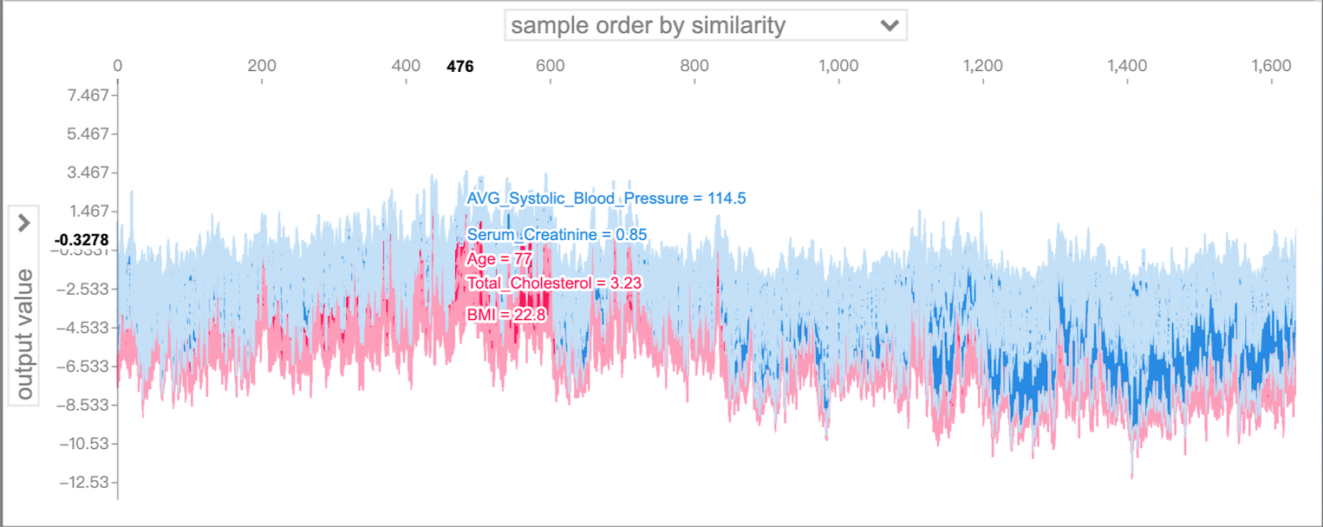
Visualization with heart disease dataset (cont.)
Risk Score: 98.382721

Slide 21
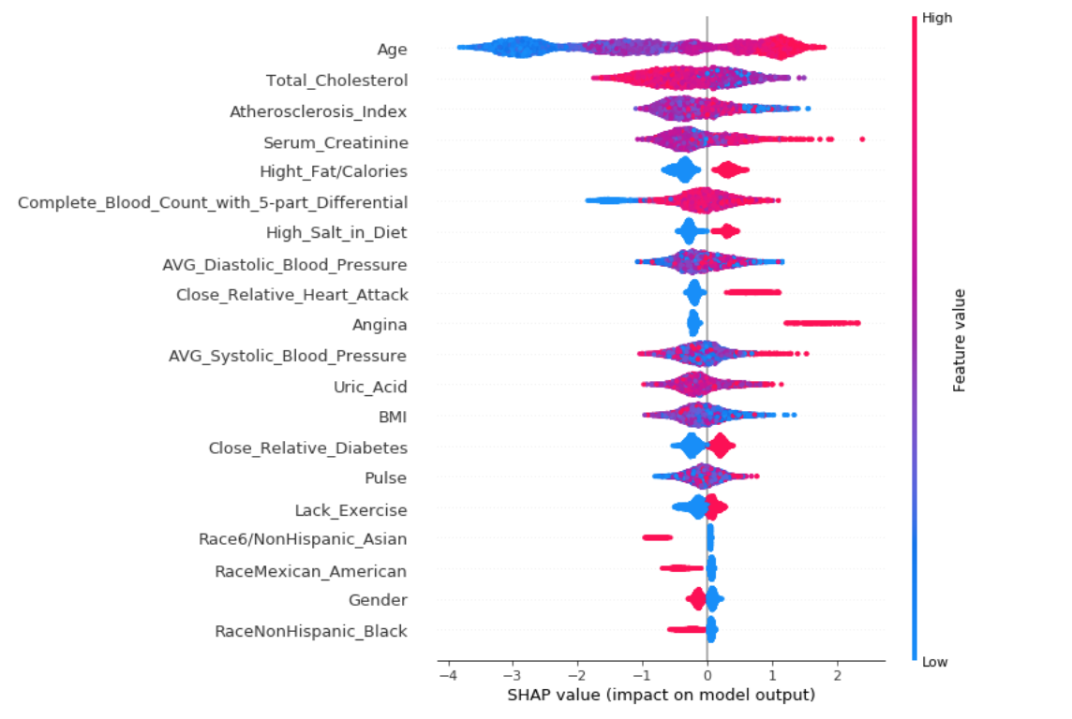
Feature Importance Summary

Slide 22
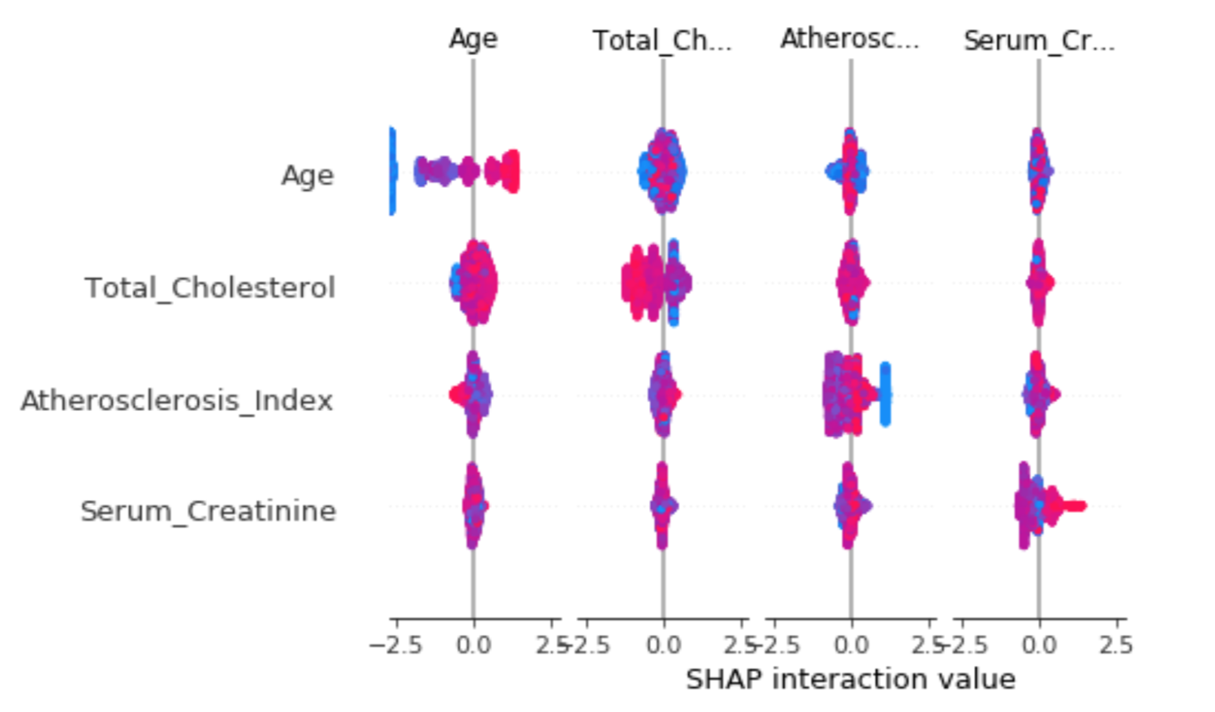
SHAP Interaction Value Summary Plot

Slide 23
Model Optimation
SHAP provides multiple explainers for different kind of models.
TreeExplainer
DeepExplainer (DEEP SHAP): Support TensorFlow and Keras models by using DeepLIFT and Shapley values.
GradientExplainer: Support TensorFlow and Keras models.
KernelExplainer (Kernel SHAP): Applying to any models by using LIME and Shapley values.

Slide 24
References
https://www.medscape.com/answers/244631-154730/is-nephrotic-syndrome-more-common-in-males-or-females
https://www.ncbi.nlm.nih.gov/pmc/articles/PMC3587111/

Slide 25
THANK YOU!

